Slide 1
REST APIs with Flask
Enzo & Olivier

Slide 2
Summary
Definition of the main concepts
Create your own Finance API
Advanced API use in Finance

Slide 3
What is an API?
An API is a program that takes in some data and gives back some other data, usually after processing it.
Web API allows for information or functionality to be manipulated by other programs via the internet. For example, with Twitter’s web API, you can write a program in a language like Python or Javascript that can perform tasks such as favoriting tweets or collecting tweet metadata.
In programming more generally, the term API, short for Application Programming Interface, refers to a part of a computer program designed to be used or manipulated by another program, as opposed to an interface designed to be used or manipulated by a human. Computer programs frequently need to communicate amongst themselves or with the underlying operating system, and APIs are one way they do it.

Slide 4
When to create and API?
Your data set is large, making download via FTP unwieldy or resource-intensive.
Your users will need to access your data in real time, such as for display on another website or as part of an application.
Your data changes or is updated frequently.
Your users only need access to a part of the data at any one time.
Your users will need to perform actions other than retrieve data, such as contributing, updating, or deleting data.

Slide 5
What is a web server?
What is a web server?
A piece of software designed to accept incoming web requests
This software has to be up and running 24/7
There are many warehouses around the world full of computers running as servers
For example, Google and Facebook have many web servers
Maybe you also know AWS (Amazon Web Services)

Slide 6
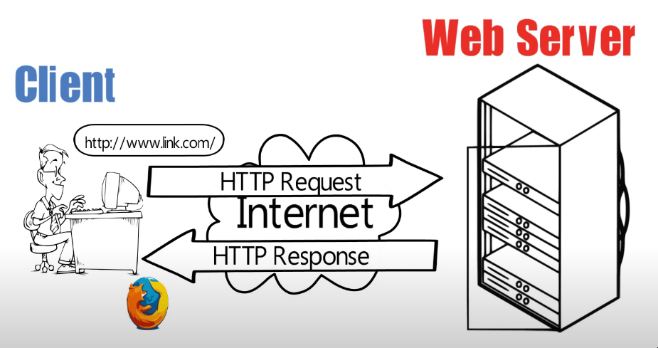

Slide 7
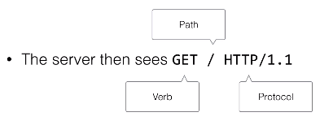
What does a request look like?
When we go to http://www.google.com in our browser, we send something to a web server

Slide 8
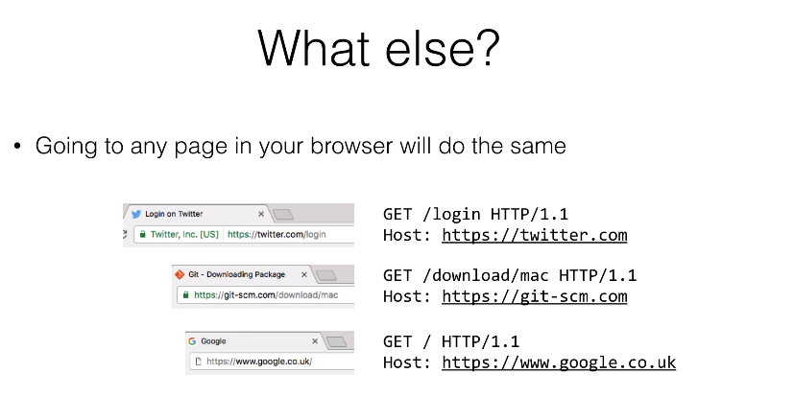

Slide 9
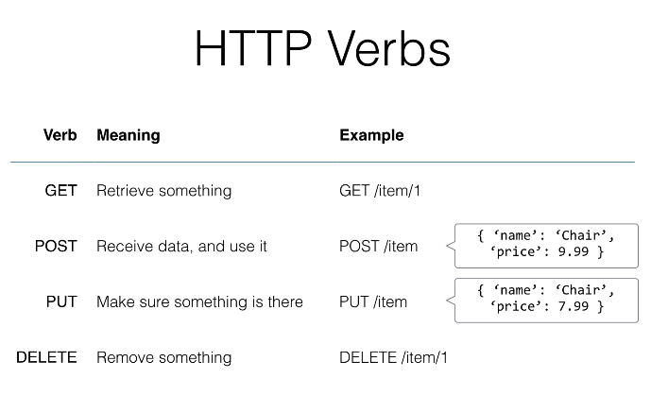
HTTP is one of the popular protocols to create interactions between two internet connected elements.

Slide 10
REST Principles
Short for Representational State Transfer
is a philosophy that describes some best practices for implementing APIs.It’s way of thinking about how a web server responds to your requests
It doesn’t respond with just data but resources
Resources?
⇒ Similar to object-oriented programming
⇒ Think of the server as having resources, and each is able to interact with the pertinent requests (GET / POST / PUT / DELETE)

Slide 11
Example of REST
Name | Path | Verb | Purpose
Index | /portfolios | GET | Display all portfolios
New | /portfolios/new | GET | Form to create a new portfolio
Create | /portfolios | POST | Create new portfolio on server
Show | /portfolios/:id | GET | Details for the specific portfolio
Edit | /portfolios/:id/edit | GET | Form to edit a portfolio
Update | /portfolios/:id | PUT | Update specific portfolio on server
Destroy | /portfolios/:id | DELETE | Deletes Item on server

Slide 12
Stateless
Another key feature is that REST is supposed to be stateless
This means one request cannot depend on any other requests
The server only knows about the current request, and not any previous requests
Example:
⇒ POST /item/chair creates an item and put it in a database
⇒ The server does not know the item exists, it has to check
⇒ GET /item/char then goes to the database and checks to see if the item is there
⇒ To get an item you do not need to have created an item before - it could be in the database from previously

Slide 13
Flask
Flask is a web framework for Python, meaning that it provides functionality for building web applications, including managing HTTP requests and rendering templates.

